Slide 1
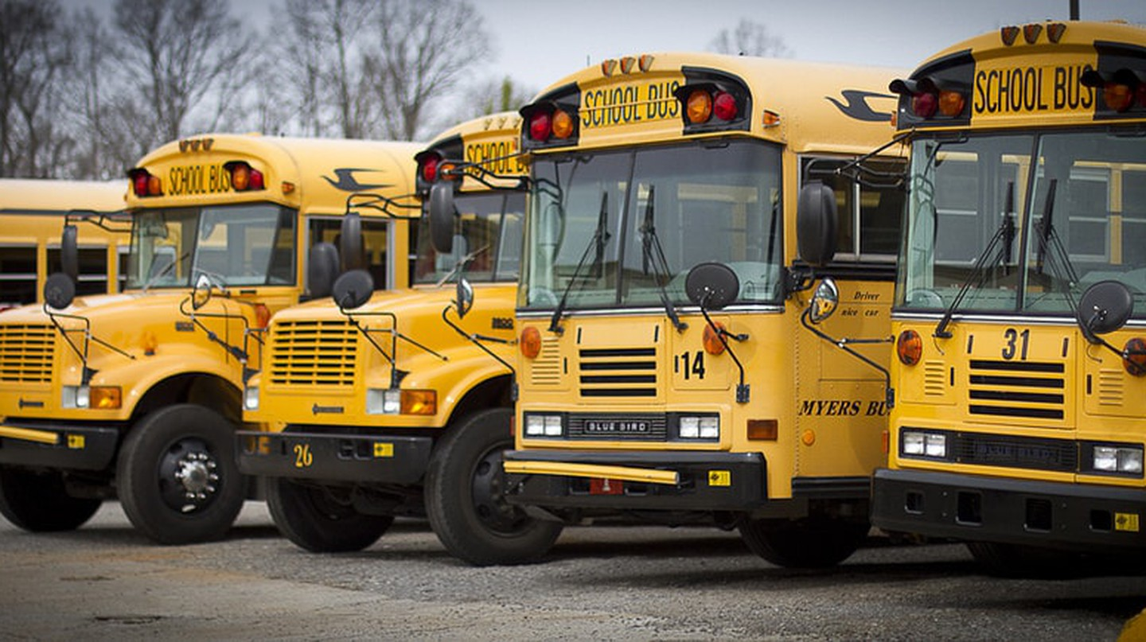

Secure your students, expedite and manage your bus tours.

Slide 2
Table of Contents
01
02
03
Business Overview
Challenges & solutions
Key Interactions
04
05
Market Research & Potential
Finances

Slide 3

Project Overview
01

Slide 4

Solution type: SaaS
Development stage: MVP
Field: Transportation
SDG: Responsible consumption
Sales model: B2B
Location: Amman
Incorporation status: Not registered

Slide 5

Challenges & Solutions
02

Slide 6



Challenges
Solutions
Absent students’ inclusion
Idle waiting time
Human routing errors
Inaccessible data
Fleet management
Clueless parents
Absence declaration
Automated notifications
Optimized routing algorithm
Interactive spreadsheets
Speed control and bus tracking
Status updates

Slide 7

KEY INTERACTIONS
03

Slide 8

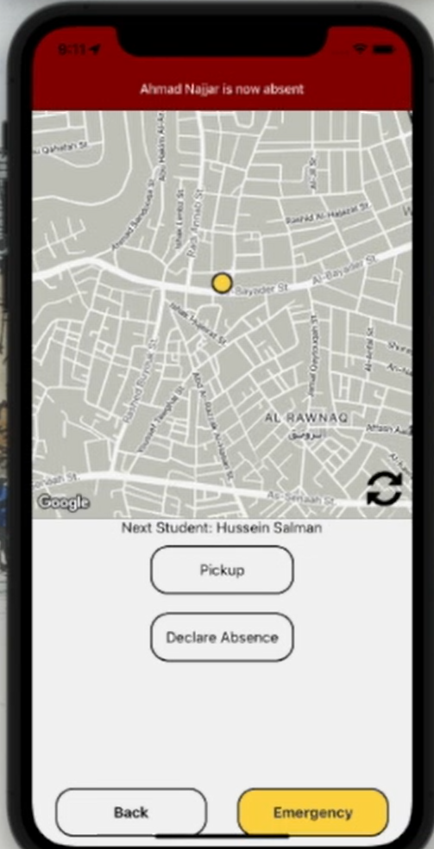
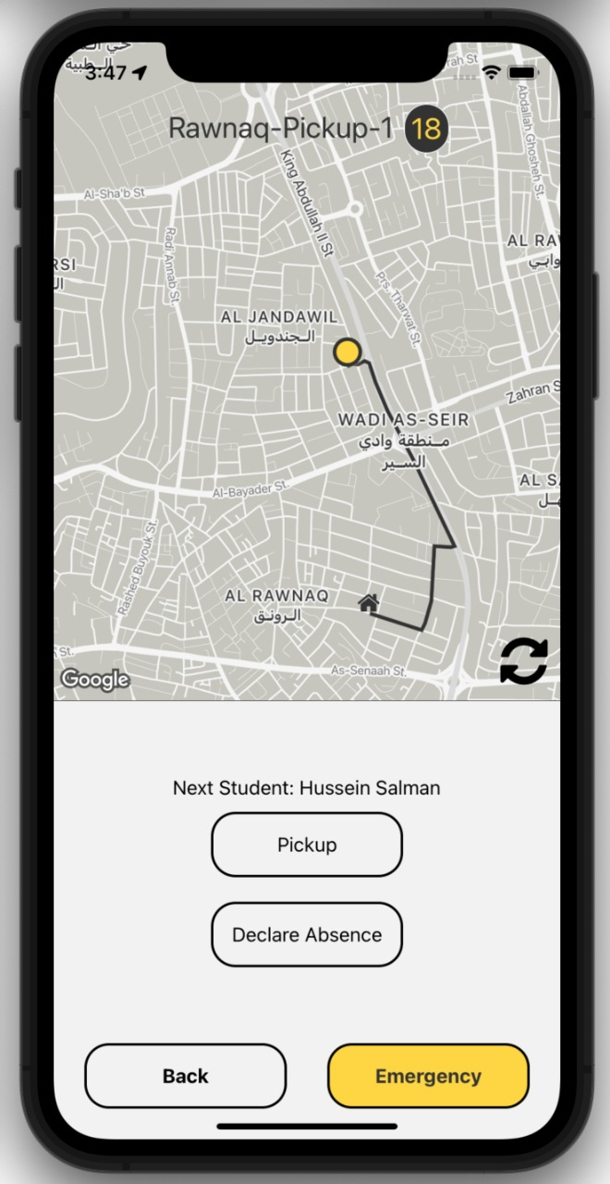
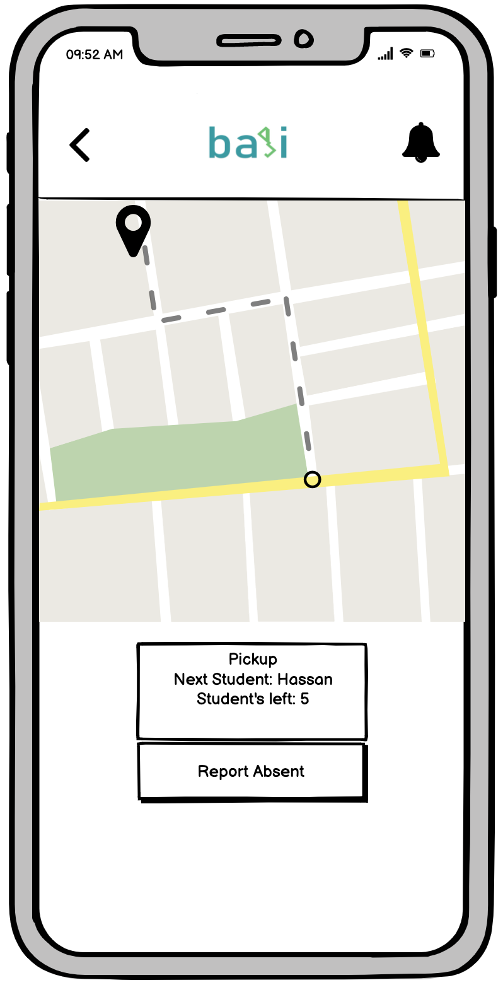
Driver
Automatic Routing
Attendance Recording
Receive Popups
Diesel purchase recording
Cleaning declaration

Slide 9
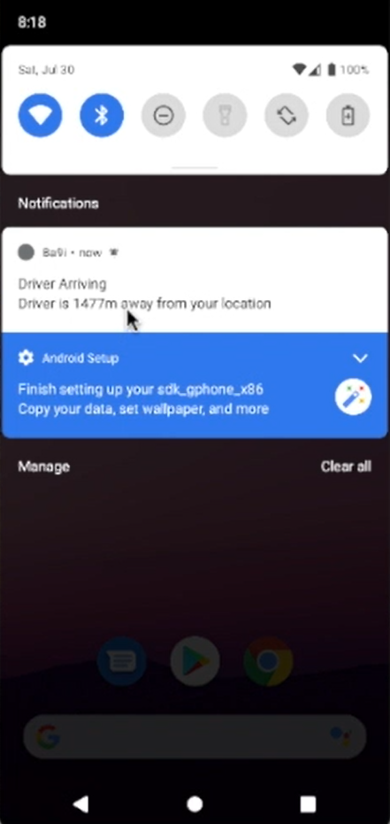
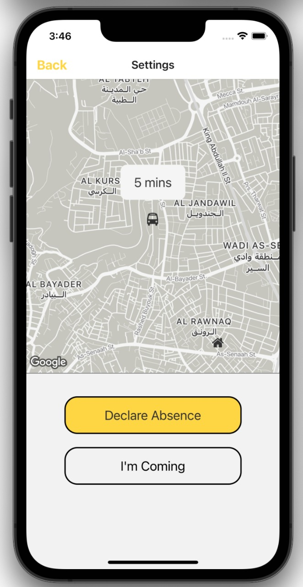
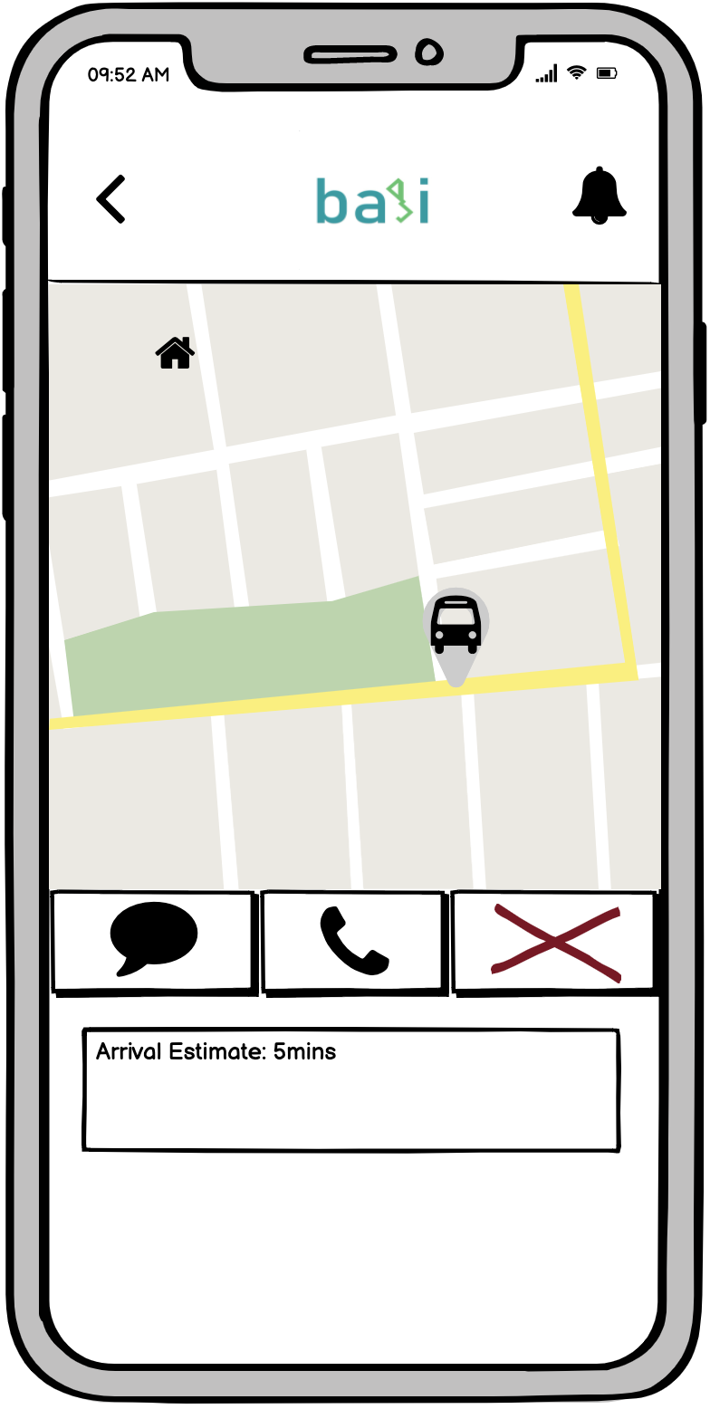
Student/Parent
Receive push notifications
Declare absence
Communication medium
Bus tracking
Rating journeys
Children sub-accounts (Parent)
Address pinning (Parent)
Status updates (Parent)

Slide 10
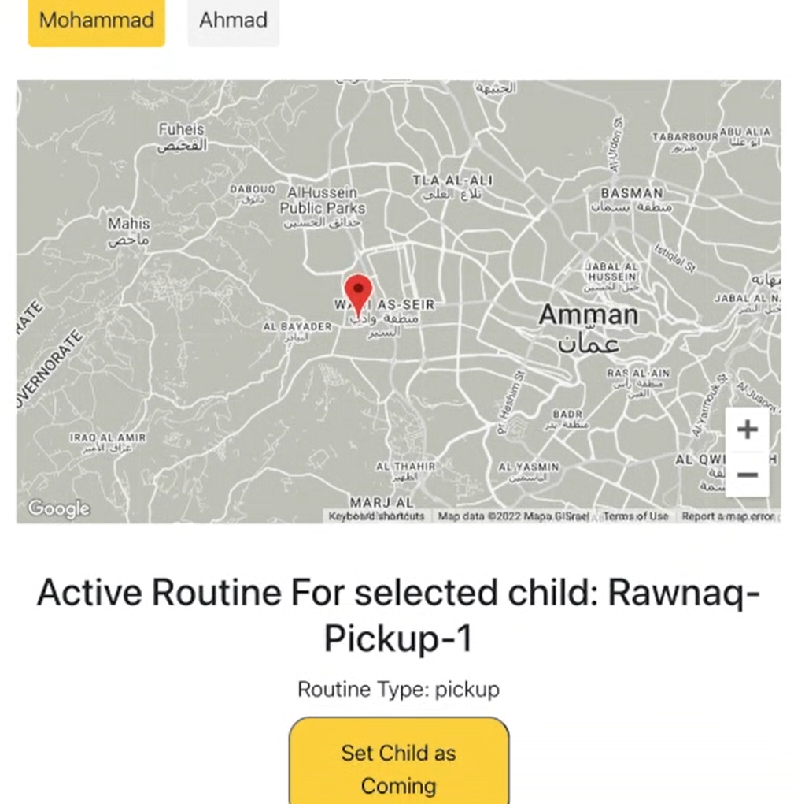
Student/Parent
Receive push notifications
Declare absence
Communication medium
Bus tracking
Rating journeys
Children sub-accounts (Parent)
Address pinning (Parent)
Status updates (Parent)

Slide 11
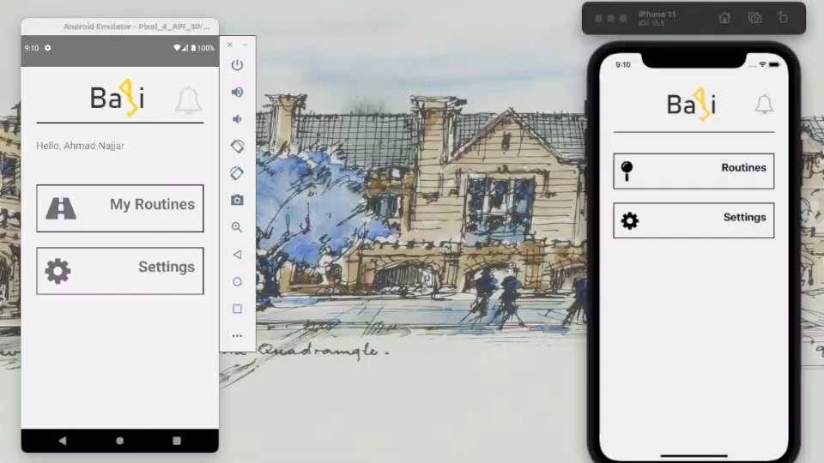
Student-Driver Interaction

Slide 12
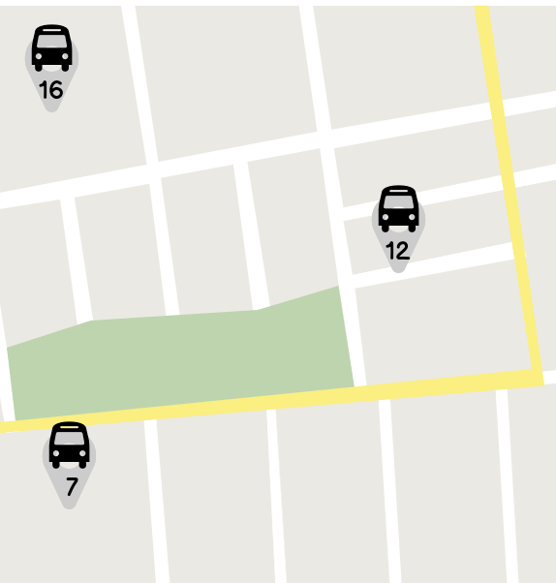
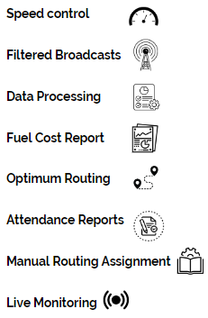
School Admin

Slide 13
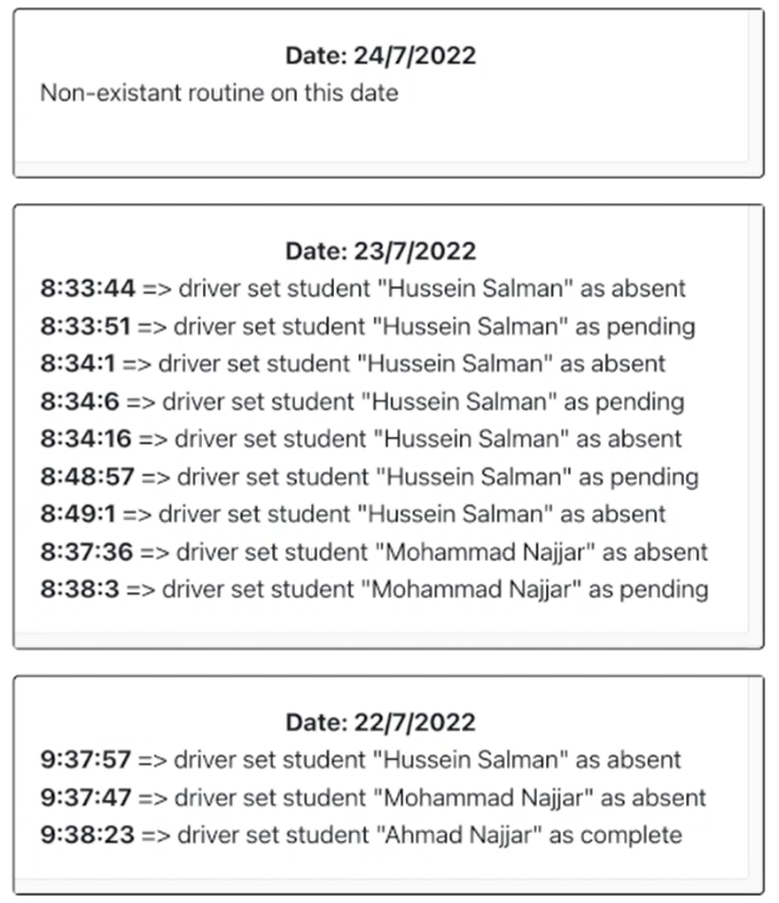
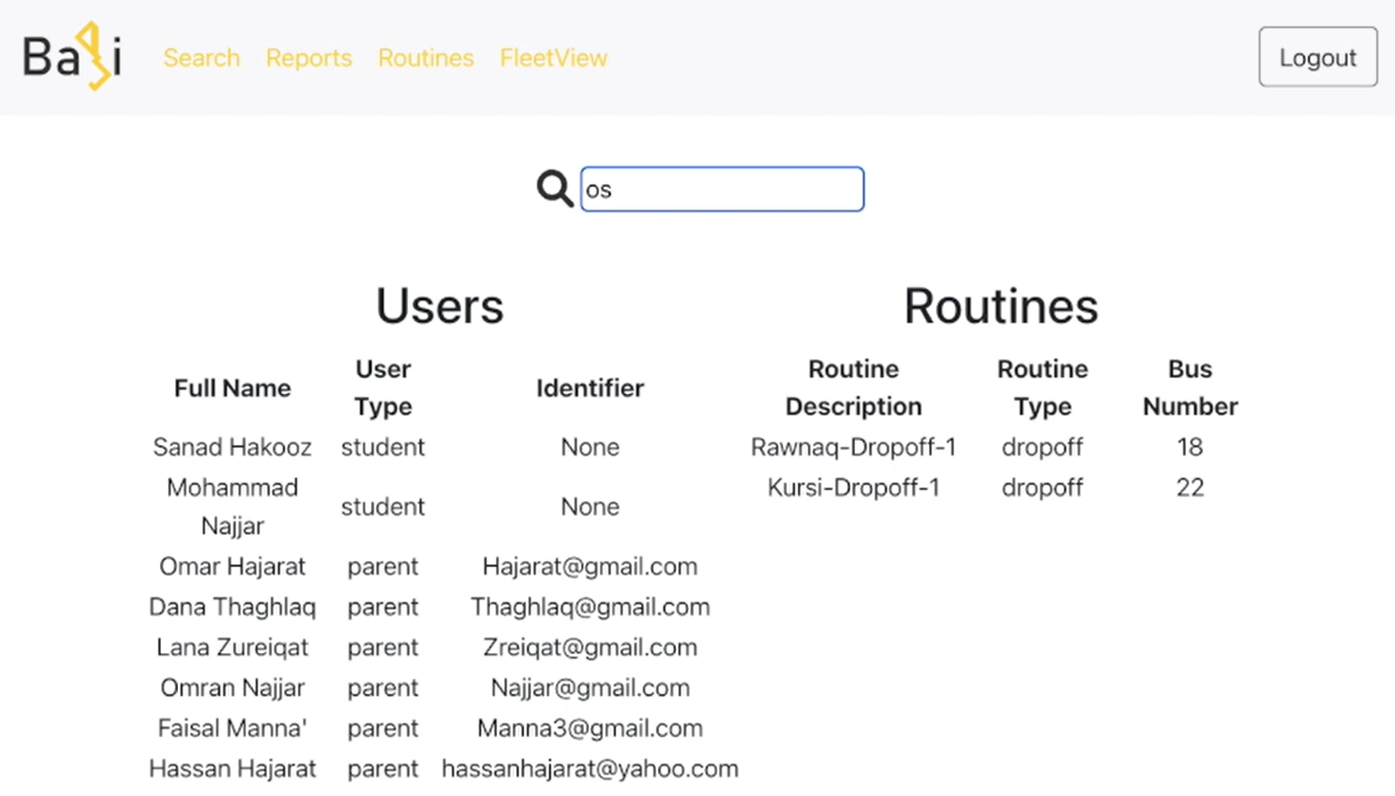
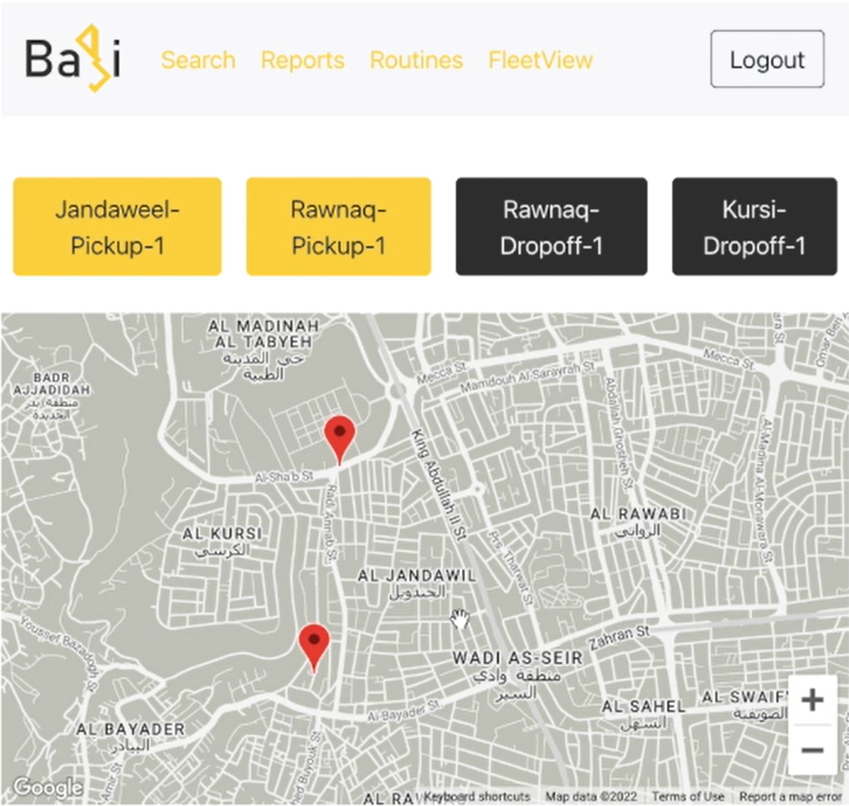
School Admin

Slide 14

Market Research & Potential
04

Slide 15
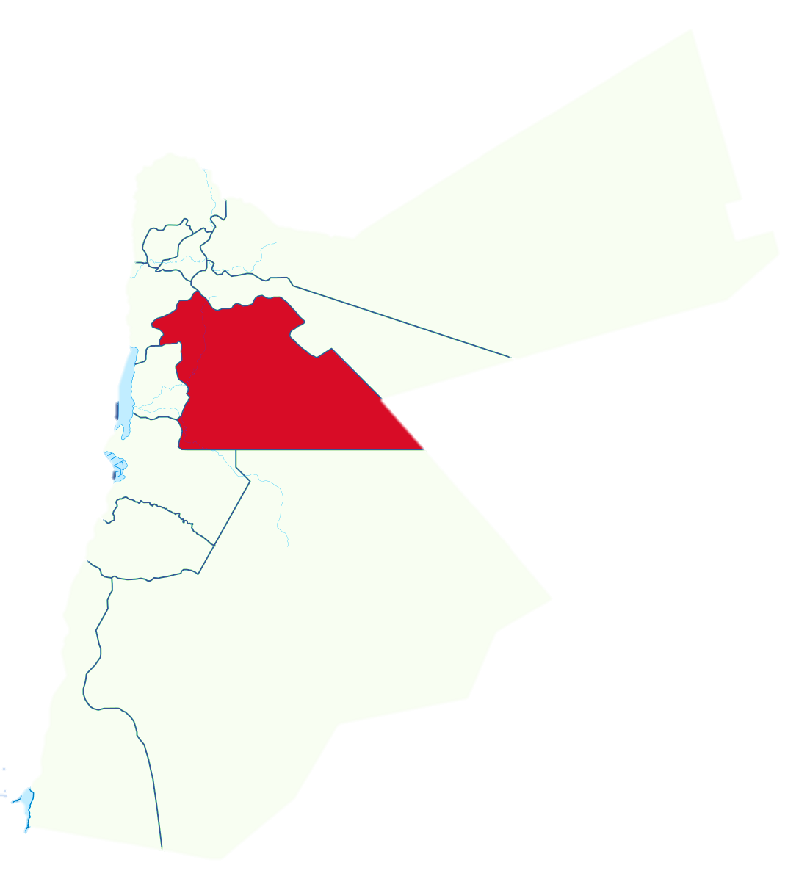
Total Addressable Market:
Private schools in Amman with more than 500 enrolled students
146 schools
with more than 35,000 students enrolled in buses

Slide 16
Market penetration
School name | Two-way Average bus fee (JOD)
De La Salle-Frere | 705
International Independent School | 775
Al Mashrek School | 800
Modern Montessori School | 790
Al- Asriyya School | 650
Amman Baptist School | 690
Modern American School | 1000
New English School | 775
Al-Maharat School | 600
International School of Choueifat | 530
National Orthodox School | 665
International Community School | 900
Al- Ra’ed Al Arabi School | 557
51%
Value route expedition

Slide 17

Pricing
Student
Bus
Admin
15 JODs
60 JODs
FREE
Semesterly
Semesterly

Slide 18
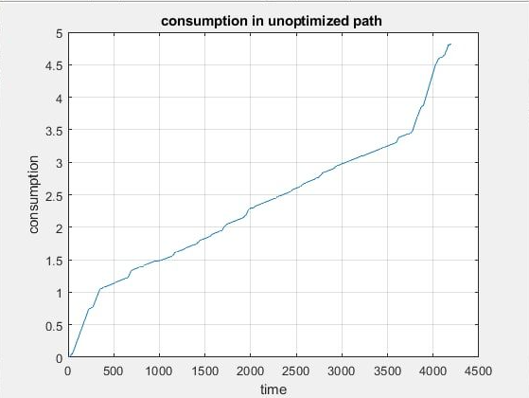
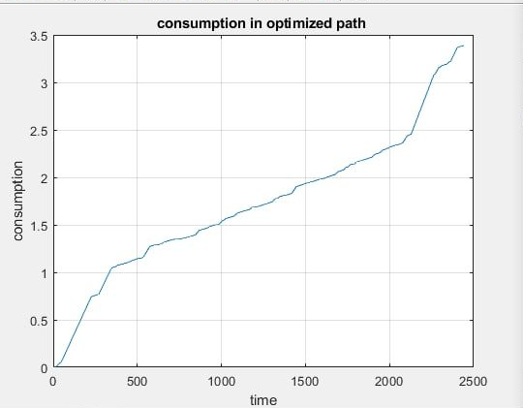


Impact simulation
Using Ba9i
Without using Ba9i
Diesel consumption per bus per routine
4 L
5.5 L
CO2 Emissions per bus per routine
3500 g
4150 g
Time consumed
41 Min.
69 Min

Slide 19

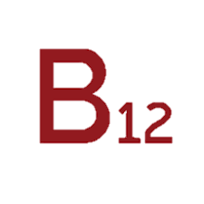




Competitor Analysis
Bus tracking
Speed control
Absence declaration
Broadcasts
Routine management
Data analysis tools
Absence records
Tasks completion tracking
Reviews & rating
Defining/pinning permanent pick-up and drop-off locations
Communication media
Interactive spreadsheets
Optimized routing
Driving trend reports

Slide 20

Finances
05

Slide 21
Financial Projections
Year | Sales acquired (Schools) | No. of users | Expenses (JOD) | Revenue (JOD) | EBITDA (JOD)
1 | 7 | 2289 | 87092 | 57009 | -30083
2 | 15 | 4905 | 104534 | 148223 | 43689
3 | 29 | 9484 | 133702 | 290744 | 157042
4 | 47 | 17623 | 173864 | 512453 | 338589
5 | 63 | 20716 | 215868 | 705430 | 489562

Slide 22
The Ask
125K JODs
Payroll
50K JODs
Product development
200K JODs
15K JODs
Rent & Utilities
10K JODs
Initial costs
We are looking for 200,000 JODs to develop the final product and operate for two years.

Slide 23

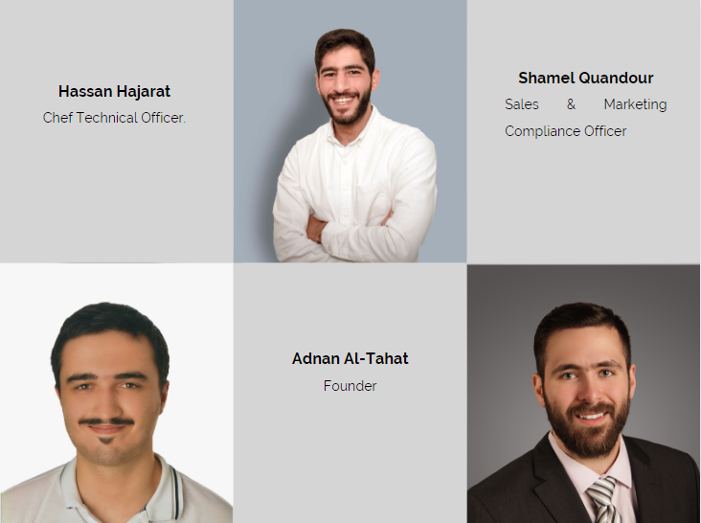
Team introduction

Slide 24
Questions?

